Slide 1

Stock Forecasting Project

Slide 2
Table of Context
Goal
First Insights
Model Selection
Results
Next Steps

Slide 3


Goal
Increasing stock availability
Decreasing leftovers
!Focus on valuable items

Slide 4
First Insights
!Data suitable for Demand Forecasting
Goal = Demand + Internal Knowledge
!Odd Data & Missing Variables
Invoice | StockCode | Description | Quantity | InvoiceDate | Price | Customer ID | Country
489434 | 85048 | 15CM CHRISTMAS GLASS BALL 20 LIGHTS | 12 | 01/12/09 07:45 | 6,95 | 13085 | United Kingdom
489434 | 79323P | PINK CHERRY LIGHTS | 12 | 01/12/09 07:45 | 6,75 | 13085 | United Kingdom
489434 | 79323W | WHITE CHERRY LIGHTS | 12 | 01/12/09 07:45 | 6,75 | 13085 | United Kingdom
489434 | 22041 | RECORD FRAME 7" SINGLE SIZE | 48 | 01/12/09 07:45 | 2,1 | 13085 | United Kingdom
489434 | 21232 | STRAWBERRY CERAMIC TRINKET BOX | 24 | 01/12/09 07:45 | 1,25 | 13085 | United Kingdom
489434 | 22064 | PINK DOUGHNUT TRINKET POT | 24 | 01/12/09 07:45 | 1,65 | 13085 | United Kingdom
489434 | 21871 | SAVE THE PLANET MUG | 24 | 01/12/09 07:45 | 1,25 | 13085 | United Kingdom
489434 | 21523 | FANCY FONT HOME SWEET HOME DOORMAT | 10 | 01/12/09 07:45 | 5,95 | 13085 | United Kingdom
489435 | 22350 | CAT BOWL | 12 | 01/12/09 07:46 | 2,55 | 13085 | United Kingdom
489435 | 22349 | DOG BOWL , CHASING BALL DESIGN | 12 | 01/12/09 07:46 | 3,75 | 13085 | United Kingdom
489435 | 22195 | HEART MEASURING SPOONS LARGE | 24 | 01/12/09 07:46 | 1,65 | 13085 | United Kingdom
489435 | 22353 | LUNCHBOX WITH CUTLERY FAIRY CAKES | 12 | 01/12/09 07:46 | 2,55 | 13085 | United Kingdom
489436 | 48173C | DOOR MAT BLACK FLOCK | 10 | 01/12/09 09:06 | 5,95 | 13078 | United Kingdom

Slide 5
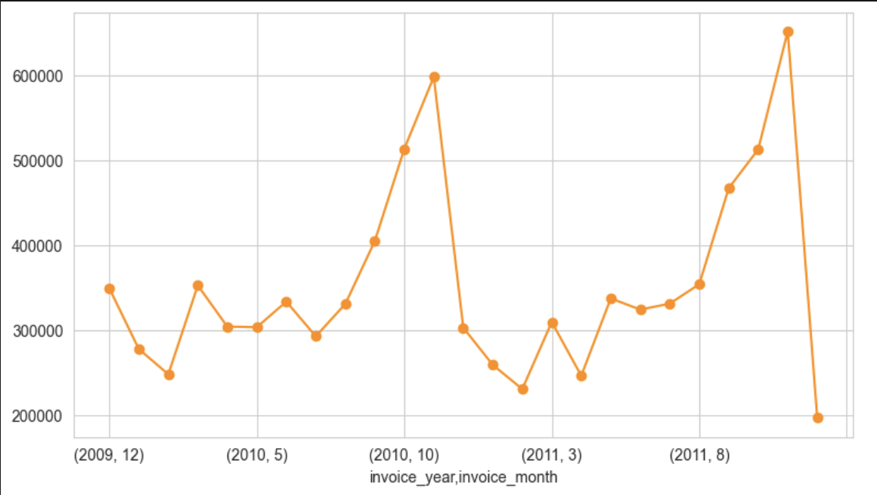
First Insights
Rollercoaster Behaviour
Peaks before Christmas period

Slide 6
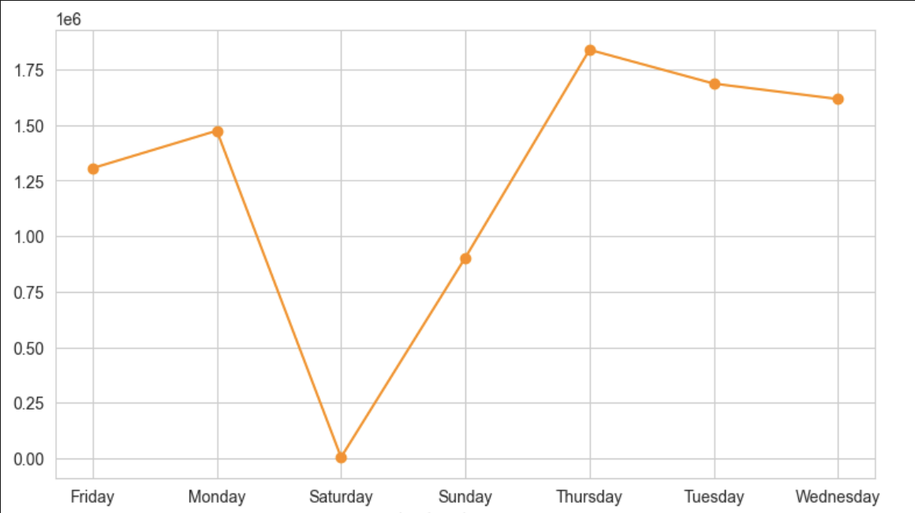
First Insights
Peak on Thursday
Drop on Saturday

Slide 7
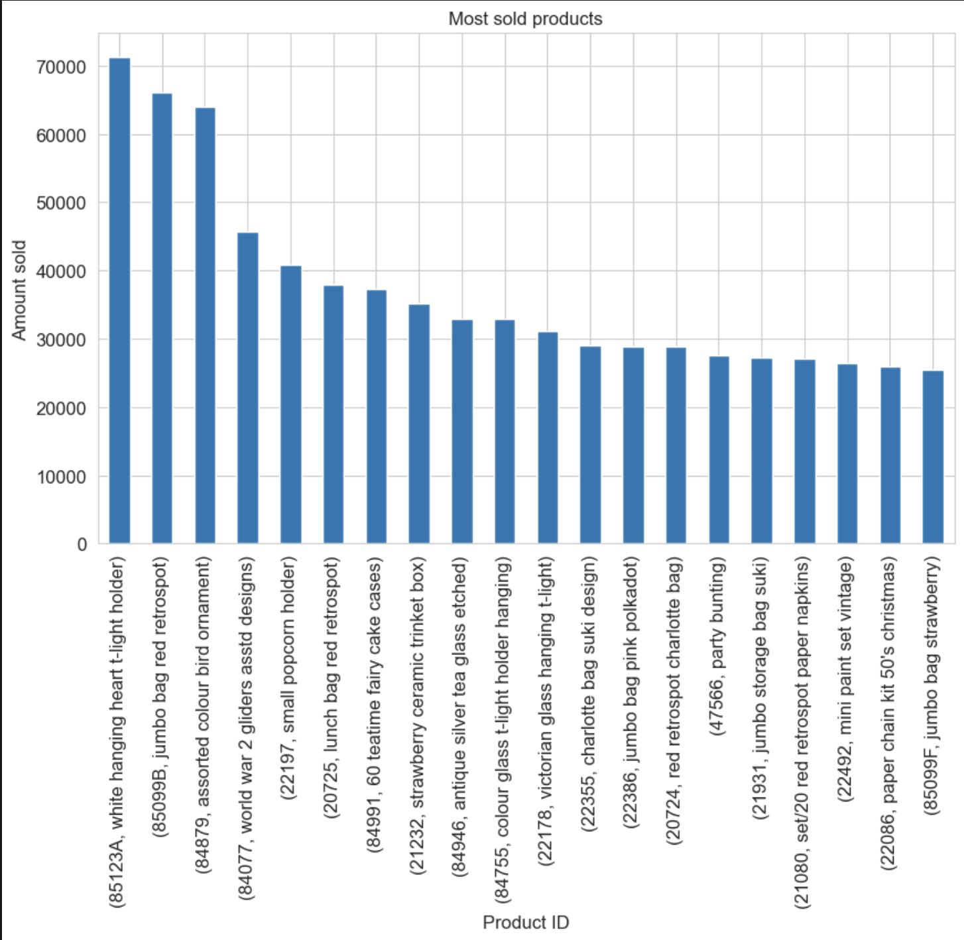
First Insights
Most Ordered Products

Slide 8
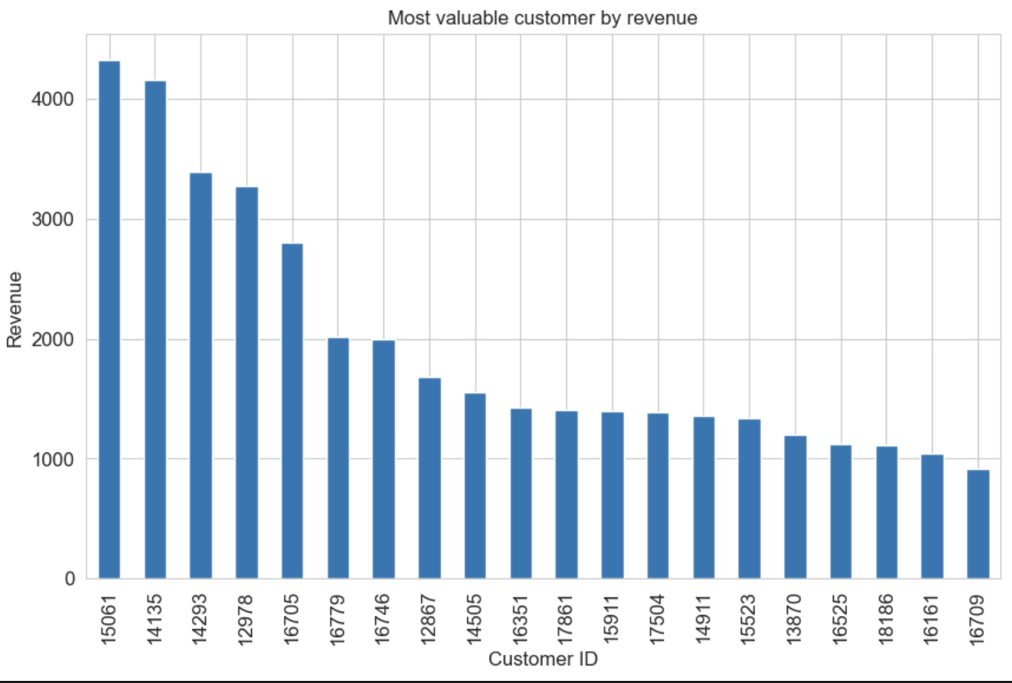
First Insights
Big Spender
Customers

Slide 9

Model Selection
CatBoost
Handles categorical dat
Robust to outliers
Often outperforms other models on structured data.
Easy way to weight items

Slide 10
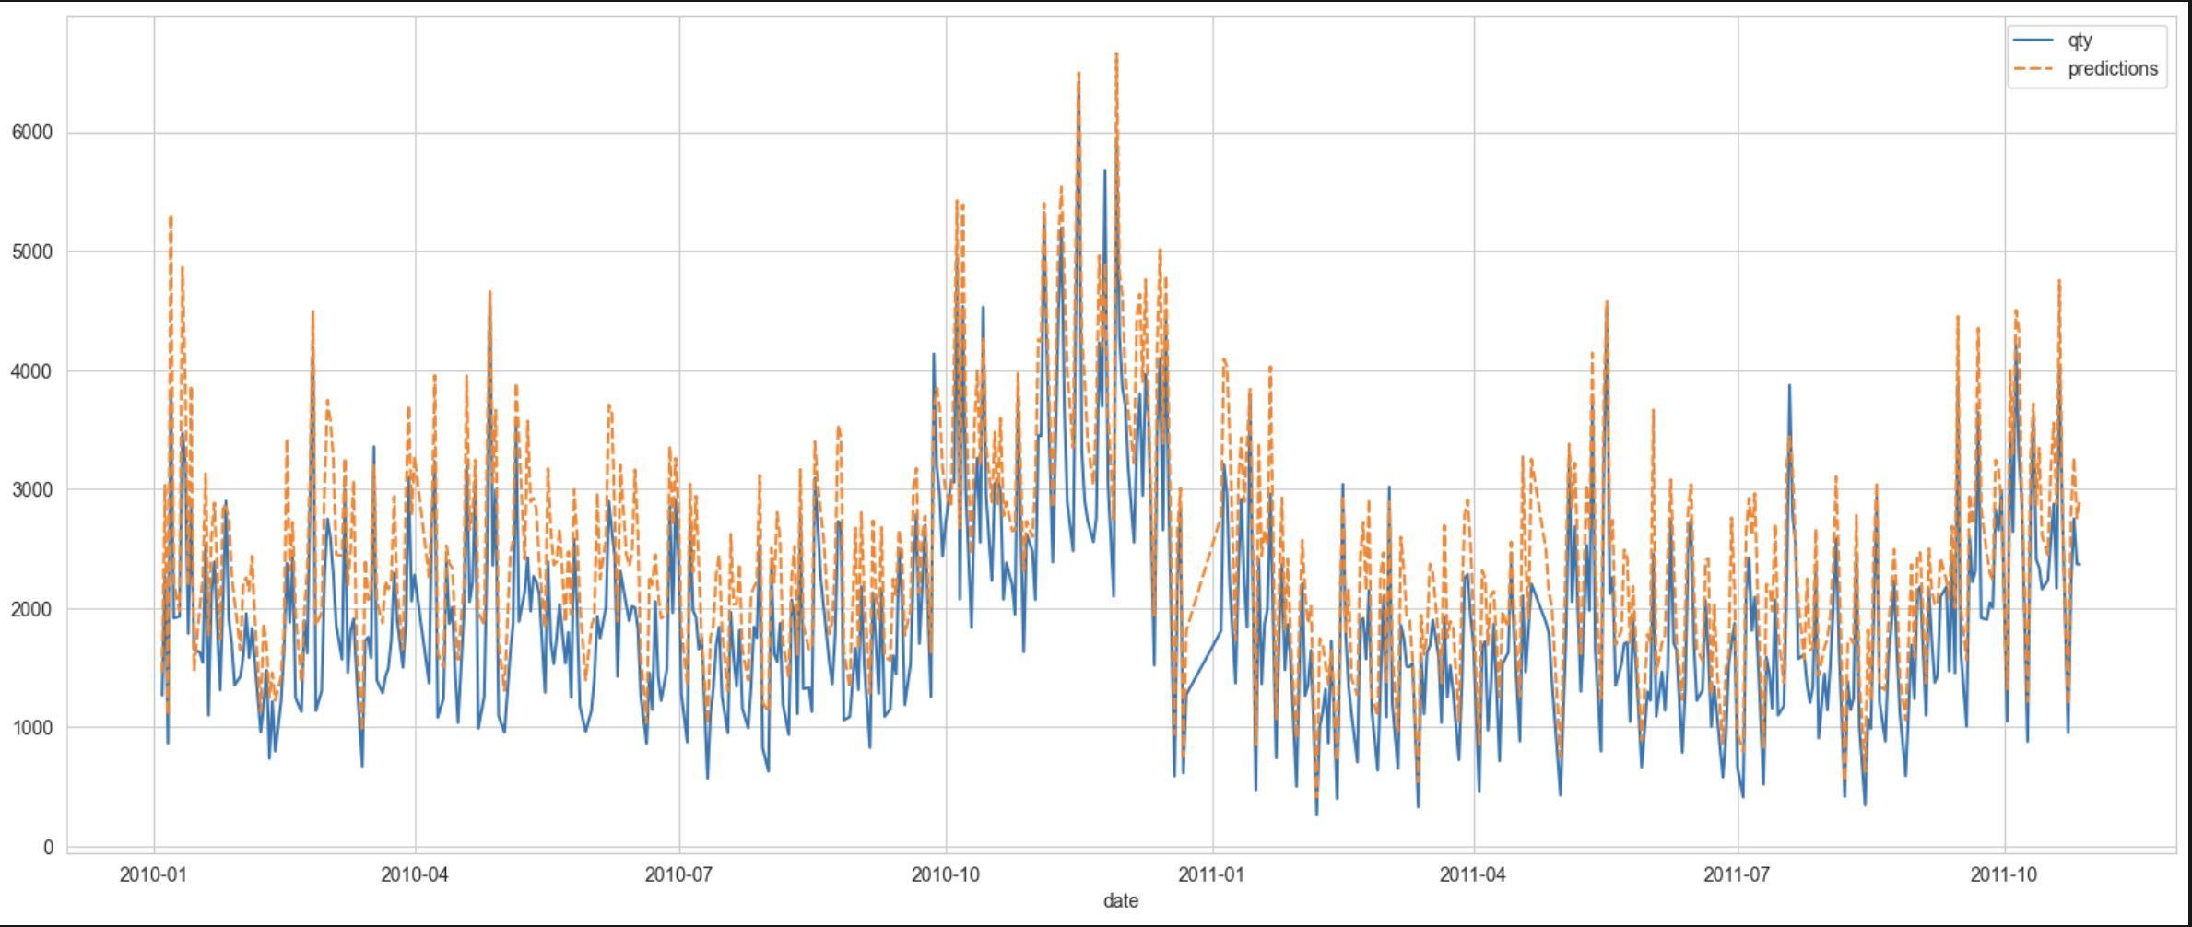
Results
Overall Results
RMSE < 19 R2 ~ 0.5

Slide 11
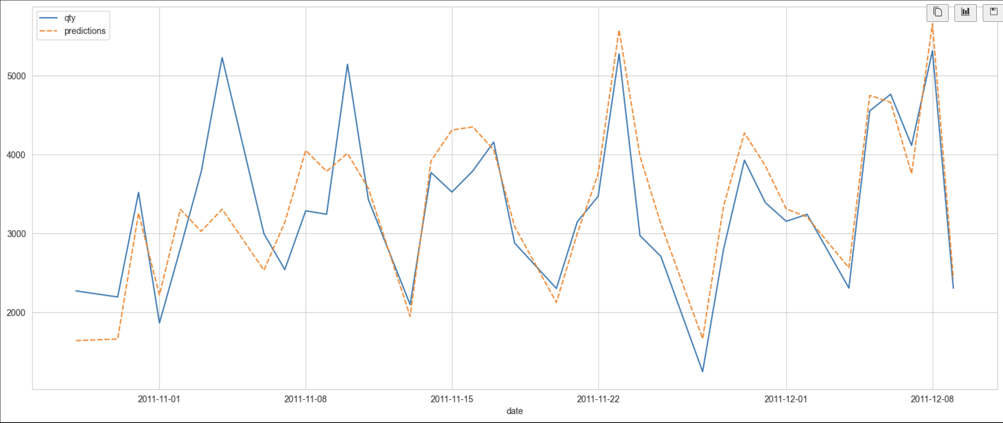
Results
Little overestimations on valuable items
Real = ~123k
Prediction = ~126k

Slide 12
Next Steps
Deployment
Understating Data
Data Collection
Model Selection
Business Needs
BI Tools
New Analysis

Slide 13

Conclusion
Odd Data -> Checking data collection software
Data Driven Decision -> Reducing guesswork, enhancing reliability
AI + Knowledge: better warehouse management
DATA + HUMAN
=

Slide 14
Q & A

